Slide 1
V
VISIONINSPECT AI
QUALITY INSPECTION
MILESTONE 3
VisionInspect AI
AI-Powered Manufacturing Defect Detection
& Quality Inspection System
VEENESHWARI R
S.D.N.B.V.C
React • FastAPI • PyTorch (YOLO)

Slide 2
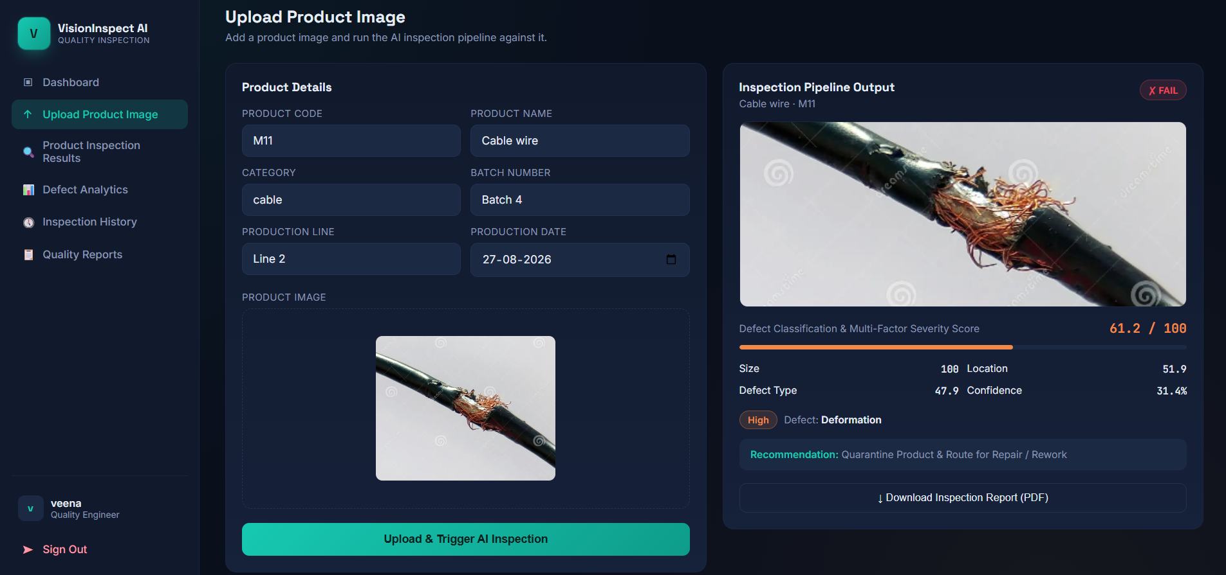



STEPS 1–3
From Image to Verdict: The Detection Pipeline
1. Defect Classification
AI detects and labels the type of defect present in the uploaded product image.
2. Severity Scoring
Combines size, location and defect-type signals into a single 0–100 severity score.
3. Quality Assessment
Auto-generates a Pass / Fail verdict with a recommended corrective action.
SAMPLE OUTPUT
Deformation • High severity • 61.2/100 • FAIL
Recommendation: Quarantine product & route for repair / rework
VisionInspect AI
03 — Detection Pipeline

Slide 3
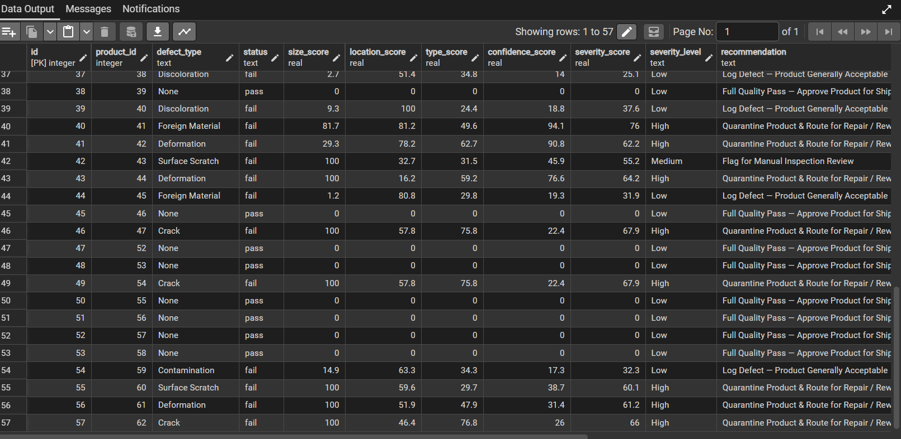
DataBase
84.5%
84.8%
Overall Accuracy
Macro Avg F1-Score
11
181
Defect Types Trained
Validation Images
STRONGEST / WEAKEST DEFECT TYPES (BY F1)
missing_component
100.0%
contamination
94.1%
hole
76.5%
crack
69.6%
Full evaluation report — defect_classifier_v3 (best.pt)
VisionInspect AI
02 — Training

Slide 4

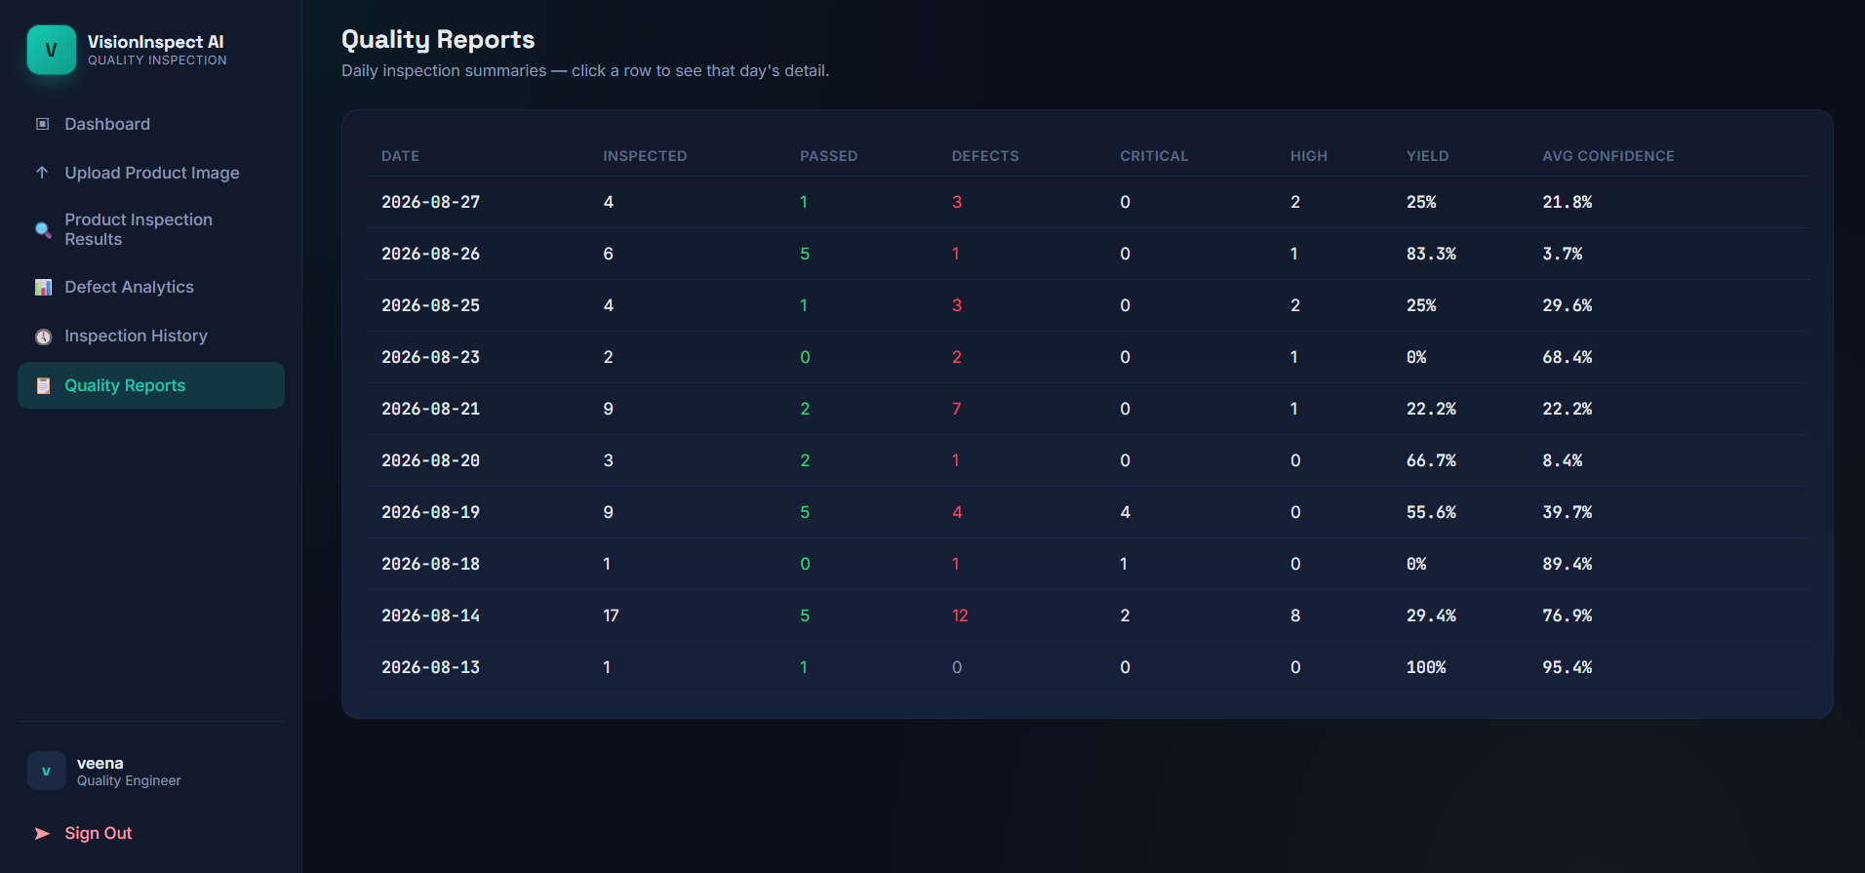
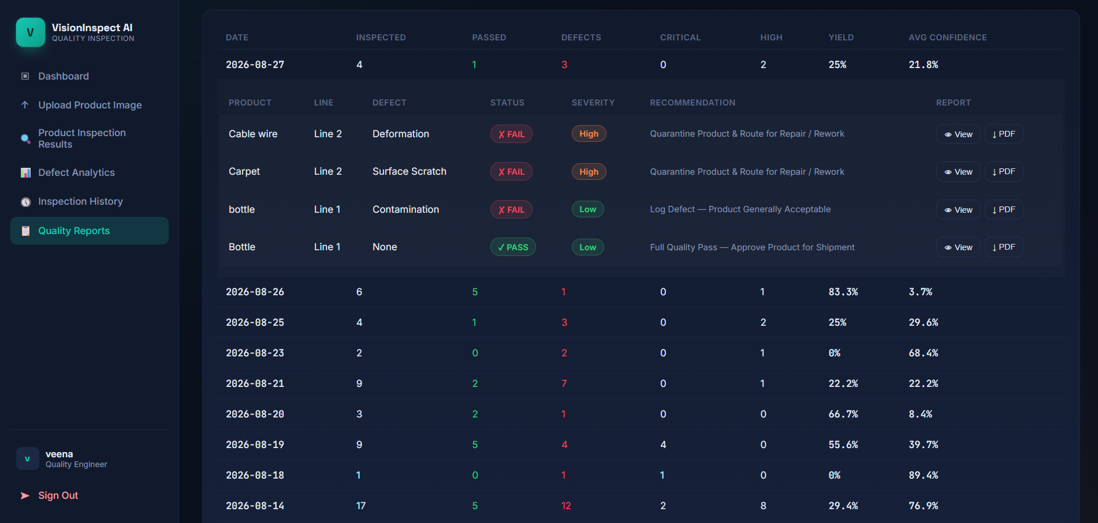
STEP 4
Quality Reports — Inspection Summaries at a Glance
Daily inspection summaries
Drill-down: per-product defect, severity & recommendation
Daily Rollup Metrics
Per-Inspection Drill-Down
Inspected, Passed & Defects per day
Critical / High severity counts
Yield % and Avg AI confidence
Product, line & defect type
Pass / Fail status & severity
Recommendation + PDF export
VisionInspect AI
04 — Quality Reports

Slide 5
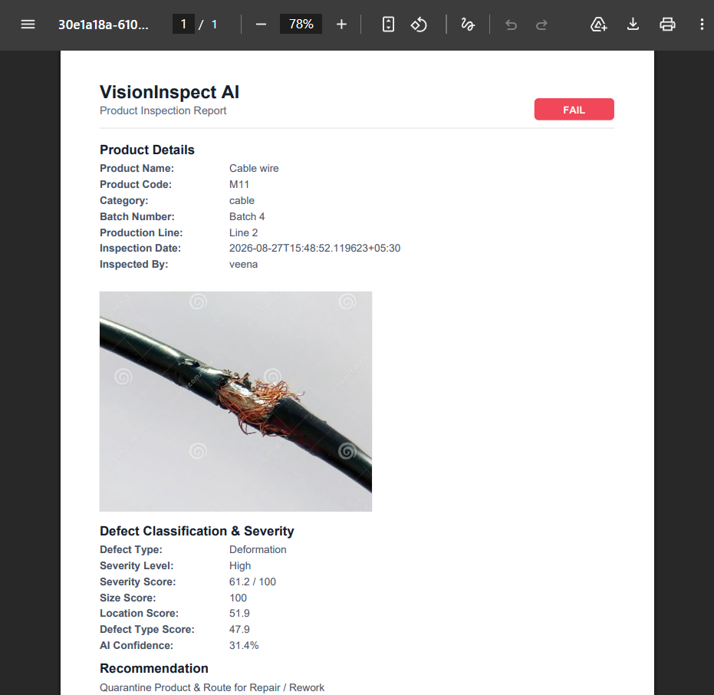
STEP 4 — CONTINUED
Auto-Generated PDF Inspection Reports
Every inspection, documented
Overall inspected count, pass rate and quality % rolled up by day
Per-inspection breakdown: product, line, defect, status & severity
Full defect classification — type, severity level, size / location / defect-type scores and AI confidence
Clear recommendation (e.g. quarantine & rework) attached to every report
One-click downloadable PDF per inspection, with a full audit trail
Sample: cable wire inspection — FAIL, High severity
VisionInspect AI
05 — Quality Reports

Slide 6

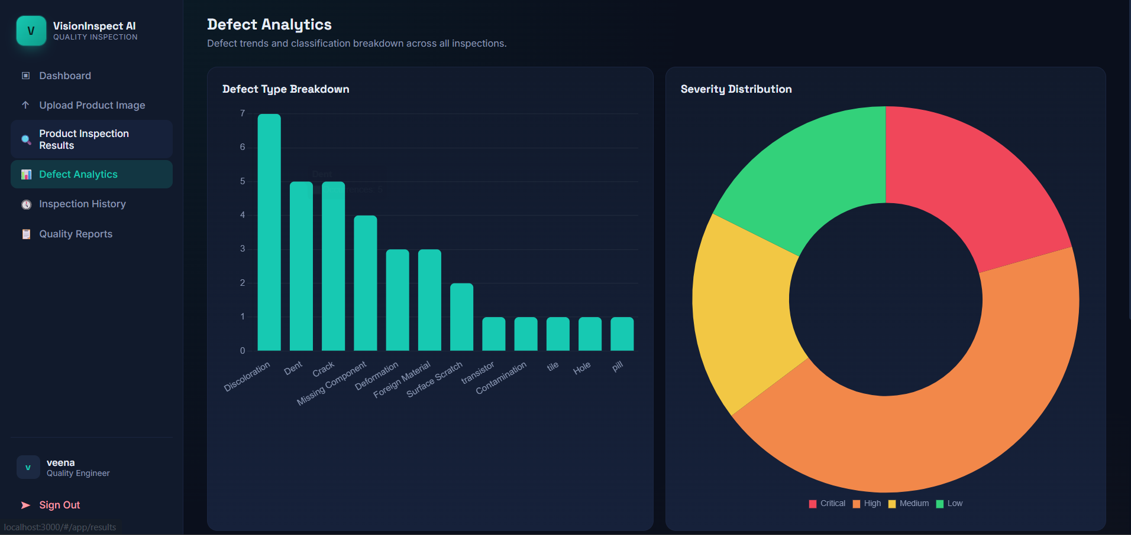
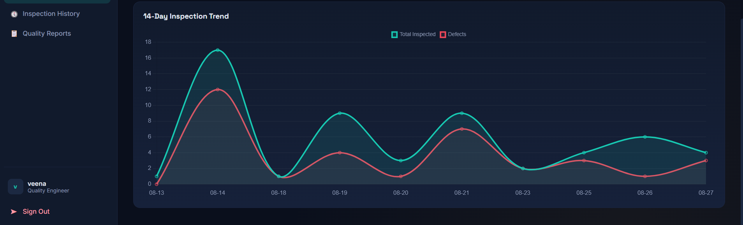
STEP 5
Defect Dashboard — Breakdown by Type & Line
14-day inspection volume vs. defects
Defect type breakdown & severity distribution across all inspections
Defect Type Breakdown — ranks every defect class by frequency across all inspections
Severity Distribution — Critical / High / Medium / Low split at a glance
Segmented by production line, so problem lines surface immediately
Critical severity
High severity
Medium severity
Low severity
VisionInspect AI
06 — Defect Dashboard

Slide 7

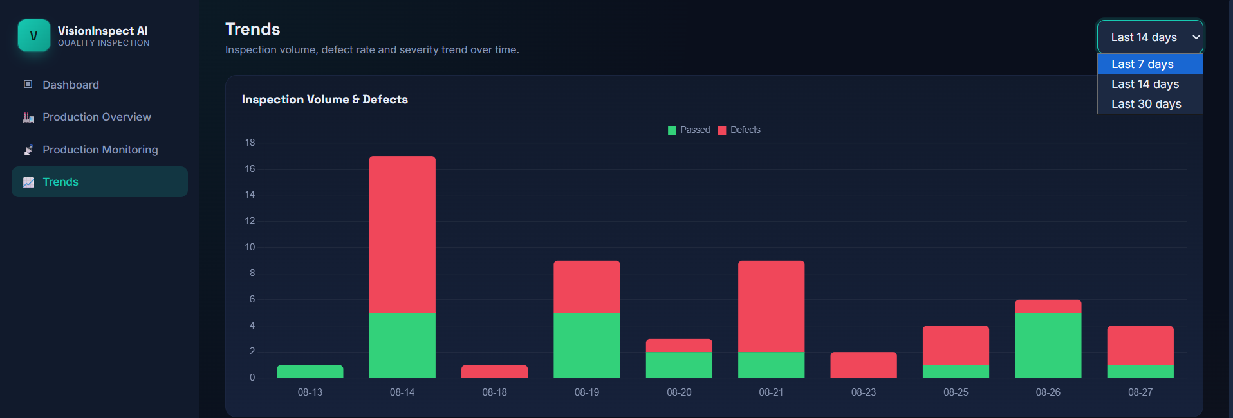
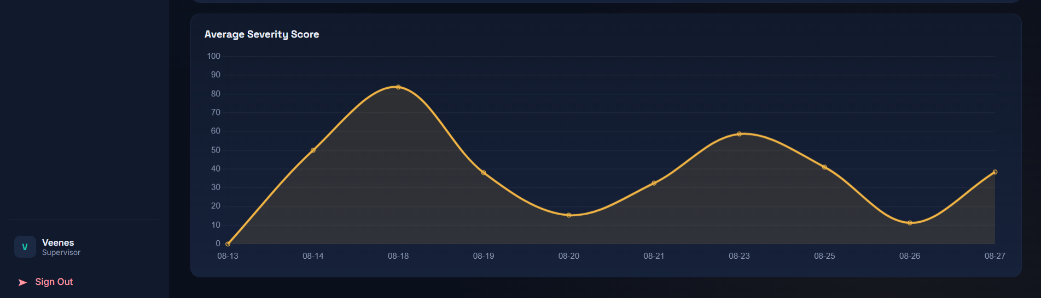
STEP 6
Trend Monitoring — Defect Trends Over Time
Inspection Volume & Defects
Selectable windows — last 7 / 14 / 30 days
Stacked view of passed vs. defective units per day
Spikes flag days needing supervisor attention
Average Severity Score
Tracks average defect severity (0–100) across the same time window
Rising trend — quality is drifting and needs a root-cause check
Gives supervisors an early warning before defect rates spike
VisionInspect AI
07 — Trend Monitoring

Slide 8
Thank You

